Slide 1

DOES IT NEED TO BE A PWA?
#FluentConf
@tzmanics

Slide 2
:
I HAVE AN AGENDA
Discuss WHAT a Progressive Web App is
Cover the 10 aspects of WHY a PWA is
WHERE PWAs are being used
Consider WHEN to use a PWA
Show you HOW to start building a PWA
#FluentConf
@tzmanics

Slide 3
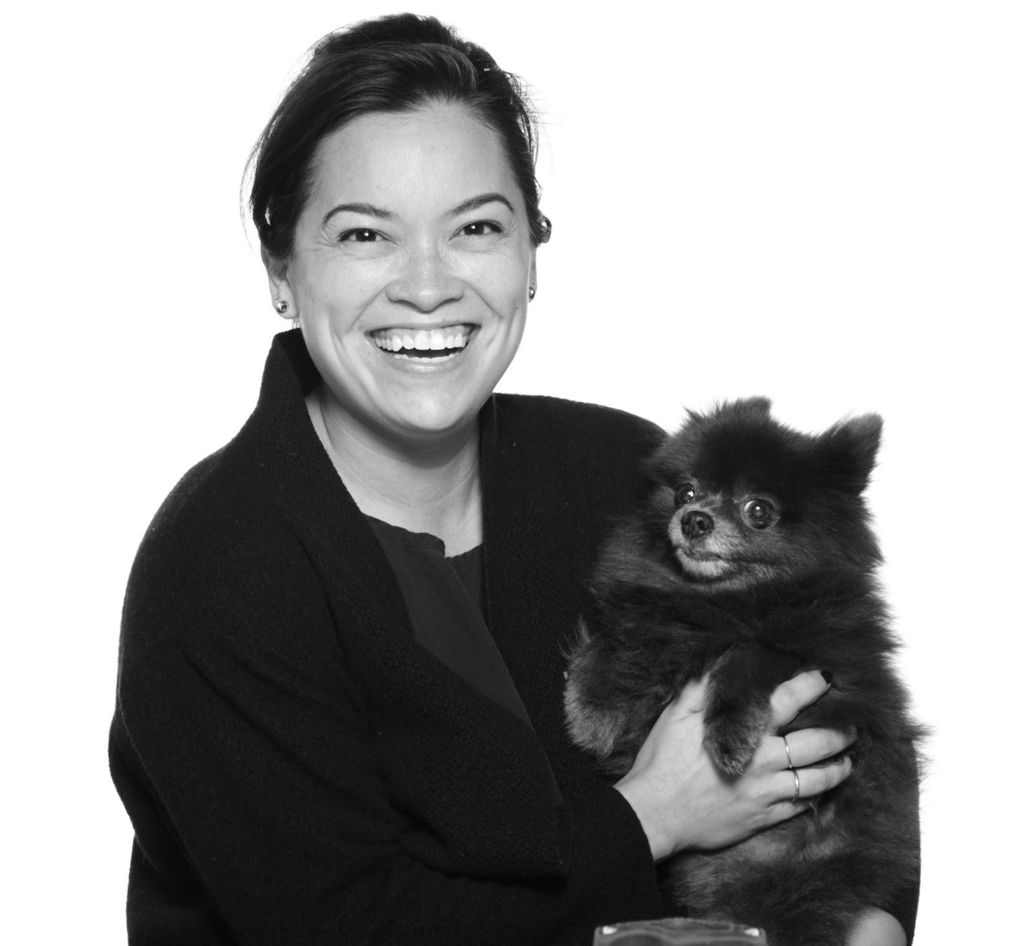
TARA Z. MANICSIC
Developer Advocate for Progress
Google Developer Expert / Web Technologies
Founder & Director Cincy Women Who Code
Founder & Director Cincy NodeSchool
@tzmanics
#toshmagosh
Notes:
3:20

Slide 4
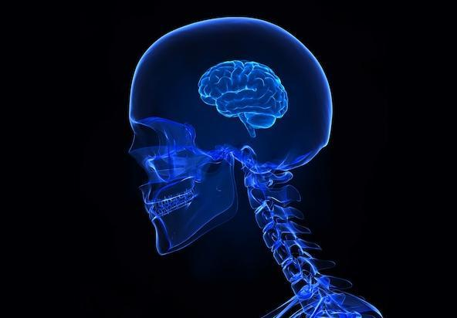
HIGH LEVEL

Slide 5

Strategies to make web apps more engaging, more reliable and more fast
Using modern web technologies like meta data, push and cache APIs.
#FluentConf
@tzmanics

Slide 6
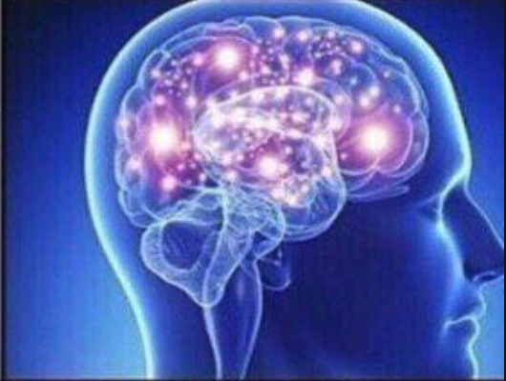
SOME OTHER LEVEL

Slide 7

You add JavaScript and json files to your project to add capabilities like push notifications, offline caching, fullscreen views and more.
#FluentConf
@tzmanics

Slide 8
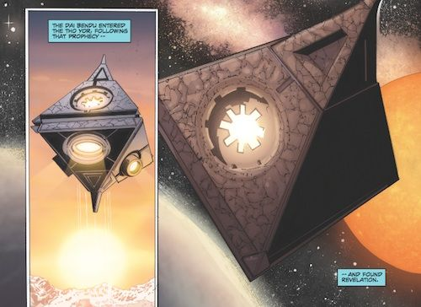
DAI BENDU LEVEL
Notes:
Mystic center

Slide 9

SERVICE WORKERS
APP MANIFEST
#FluentConf
Notes:
5:00

Slide 10
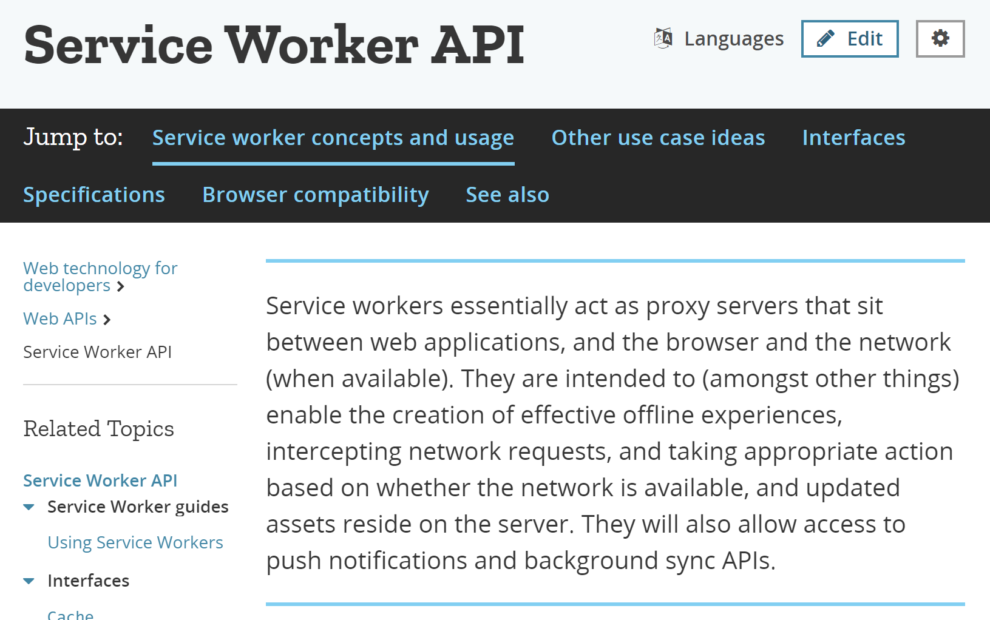
#FluentConf
@tzmanics

Slide 11
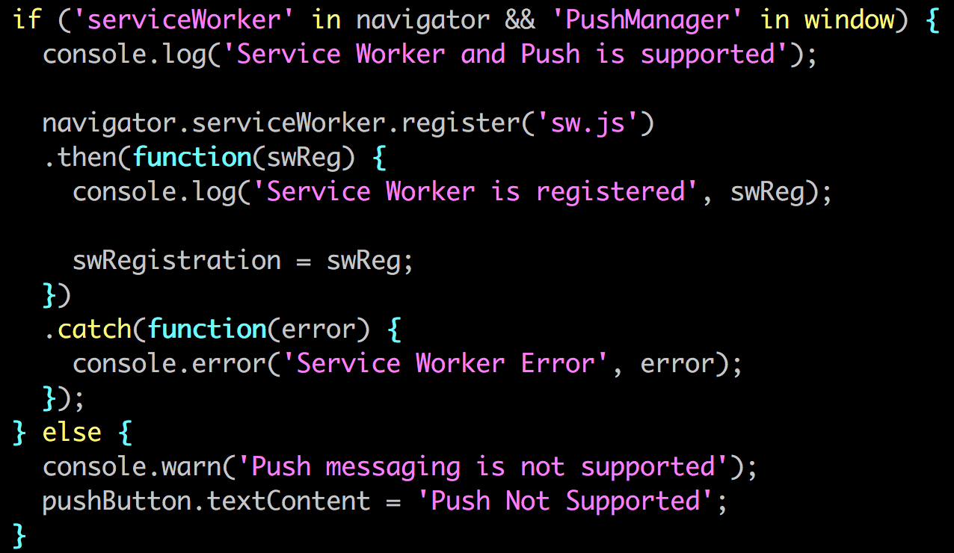
serviceworker.js
#FluentConf
@tzmanics
@TZMANICS
Notes:
8

Slide 12
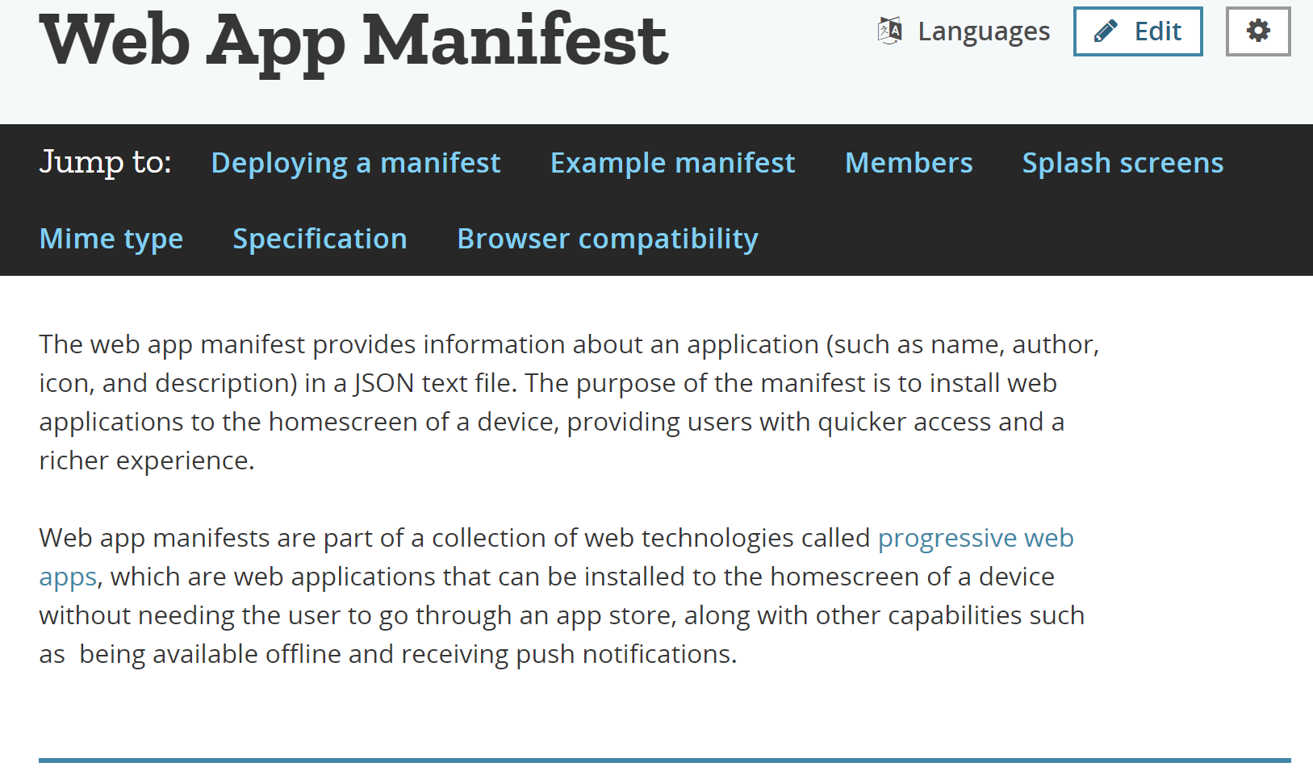
#FluentConf
@tzmanics
@TZMANICS

Slide 13
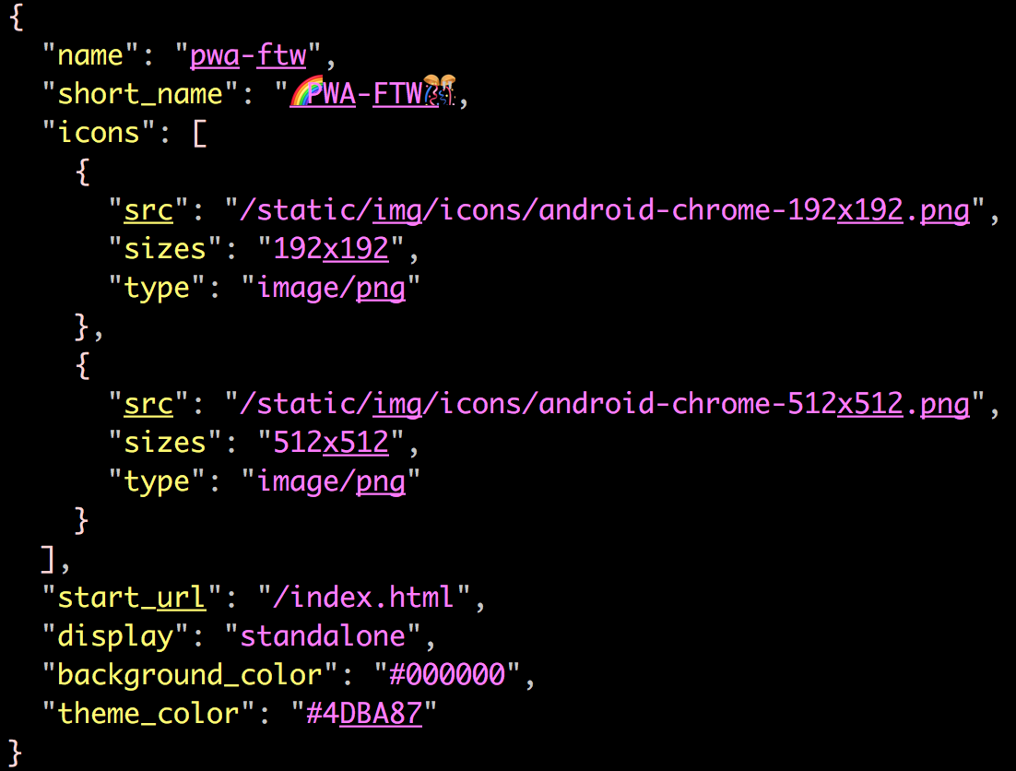
manifest.json
#FluentConf
@tzmanics
@TZMANICS

Slide 14
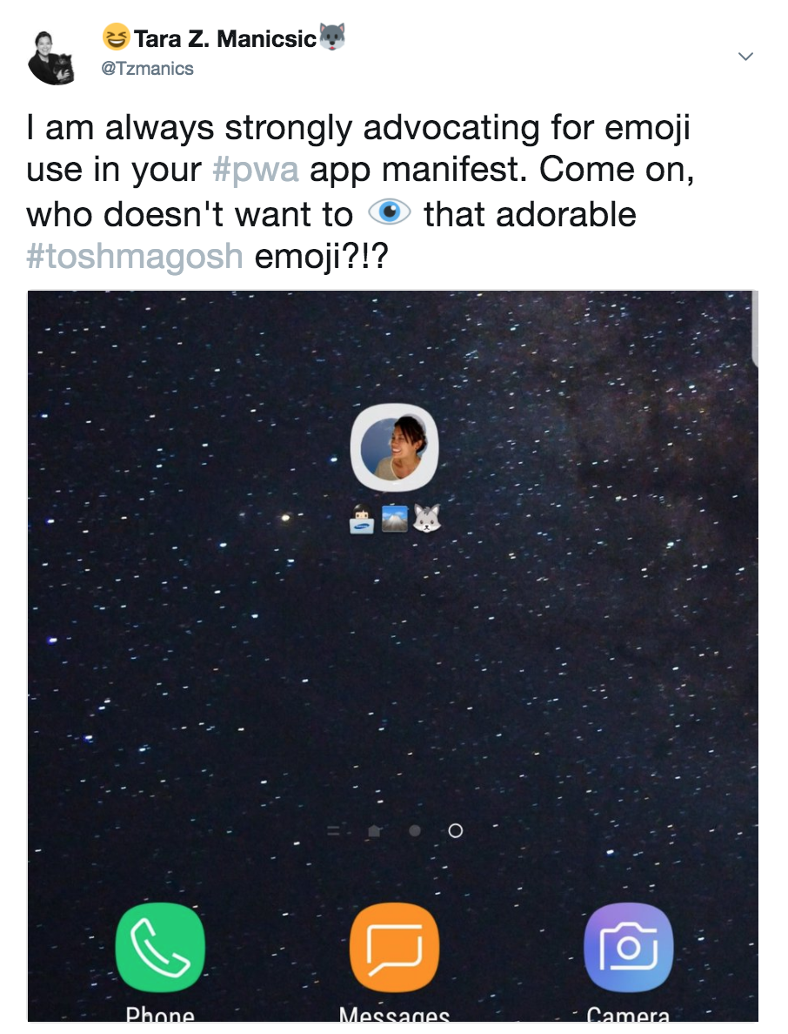
#FluentConf
@tzmanics
Notes:
11:!5

Slide 15

WHAT NOT?

Slide 16
REPLACING NATIVE MOBILE APPS
NOT
#FluentConf
@tzmanics

Slide 17
NOT
JUST MOBILE
#FluentConf
@tzmanics

Slide 18
NOT
FOR EVERYONE
#FluentConf
@tzmanics

Slide 19
NOT
ALL || NOTHING
#FluentConf
@tzmanics

Slide 20
A REASON TO BURN IT TO THE GROUND
NOT
#FluentConf
@tzmanics
Notes:
16

Slide 21

PROGRESSIVE
#FluentConf
@tzmanics

Slide 22
RESPONSIVE
#FluentConf
@tzmanics

Slide 23
CONNECTIVITY INDEPENDENT
#FluentConf
@tzmanics

Slide 24
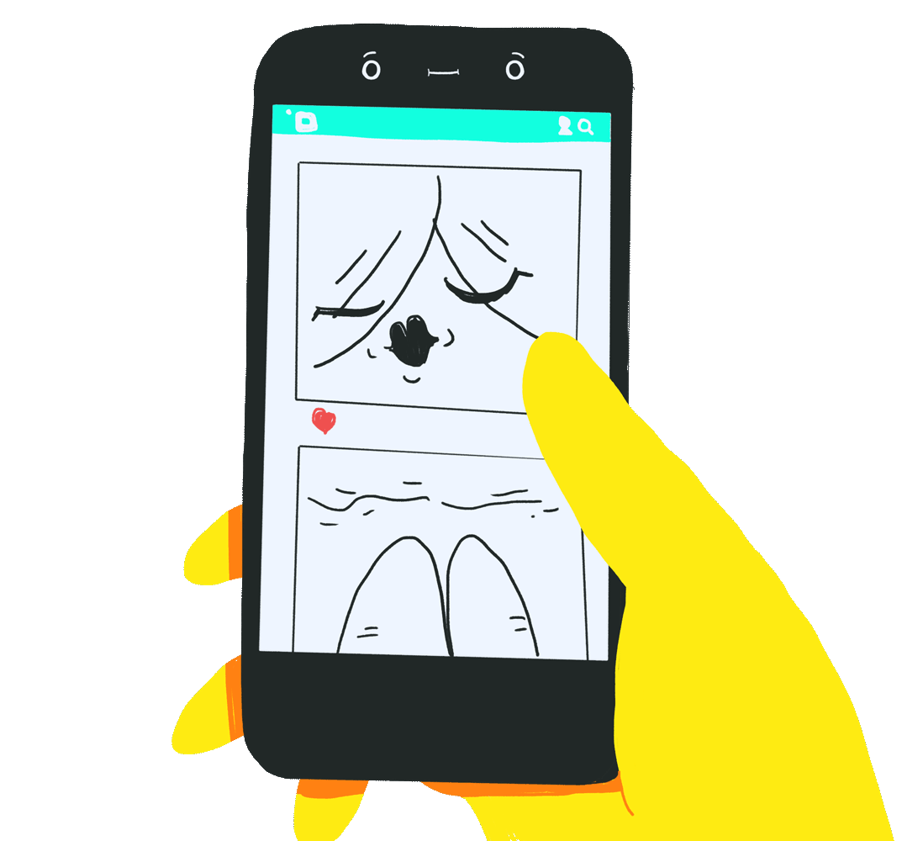
APP-LIKE
#FluentConf
@tzmanics

Slide 25
FRESH
#FluentConf
@tzmanics
Notes:
20
Always up-to-date thanks to the service worker update process.

Slide 26

SAFE
#FluentConf
@tzmanics

Slide 27
DISCOVERABLE
#FluentConf
@tzmanics
Notes:
24 Is identifiable as an "application" thanks to W3C manifest and service worker registrationscope, allowing search engines to find it.

Slide 28
RE-ENGAGING
#FluentConf
@tzmanics

Slide 29

INSTALLABLE
#FluentConf
@tzmanics
Notes:
The web app is not already installed
Meets a user engagement heuristic (currently, the user has interacted with the domain for at least 30 seconds)
Includes a web app manifest that includes:
short_name or name
icons must include a 192px and a 512px sized icons
start_url
display must be one of: fullscreen, standalone, or minimal-ui
Served over HTTPS (required for service workers)
Has registered a service worker with a fetch event handler

Slide 30
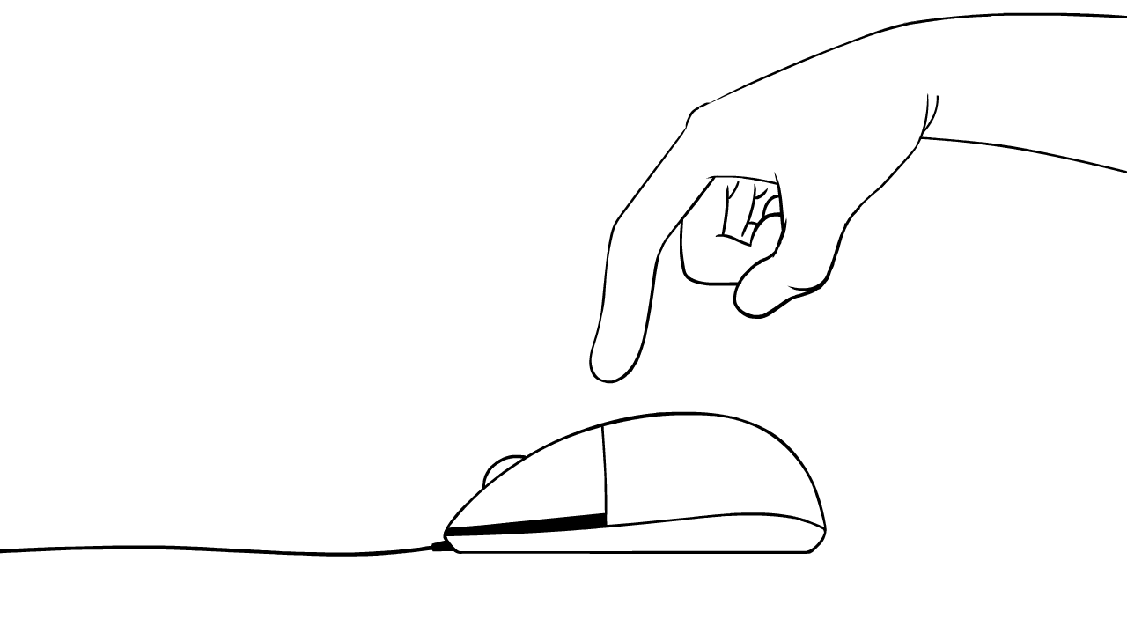
LINKABLE
#FluentConf
@tzmanics
Notes:
25

Slide 31





#FluentConf
@tzmanics
Notes:
Alex russel

Slide 32









#FluentConf
@tzmanics
Notes:
28

Slide 33

DOES IT NEED TO BE A PWA?

Slide 34


DATA ENTRY
progressive
responsive
connectivity independent
app-like
fresh
safe
installable
discoverable
re-engaging
linkable
@tzmanics

Slide 35
YOUR BLOG
responsive
app-like
fresh
linkable
progressive
connectivity independent
safe
discoverable
re-engaging
installable
#FluentConf
@tzmanics

Slide 36
ECOMMERCE
responsive
fresh
safe
re-engaging
linkable
progressive
connectivity independent
app-like
discoverable
installable
#FluentConf
@tzmanics

Slide 37
CONTRACTOR SITE
responsive
fresh
safe
discoverable
re-engaging
linkable
progressive
connectivity independent
app-like
installable
#FluentConf
@tzmanics

Slide 38

















Slide 39


LIVE CODING
@TZMANICS
Notes:
30:00

Slide 40
<live-code-screenshots>

Slide 41
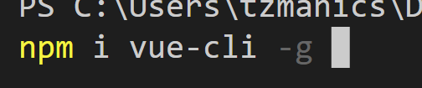
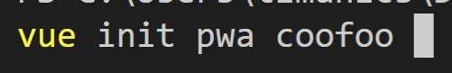

Slide 42
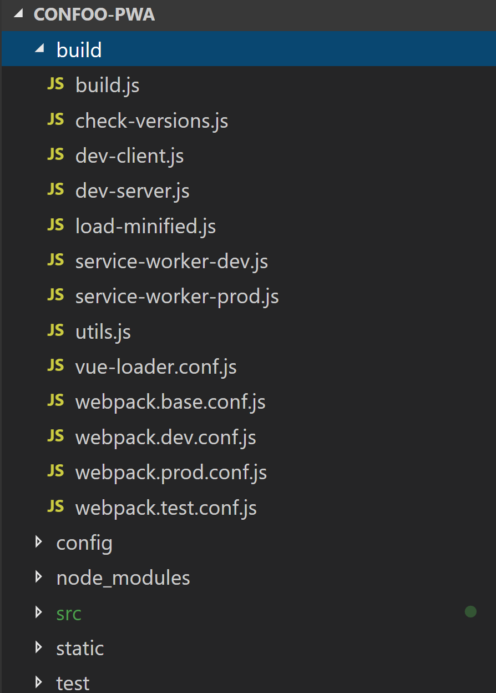
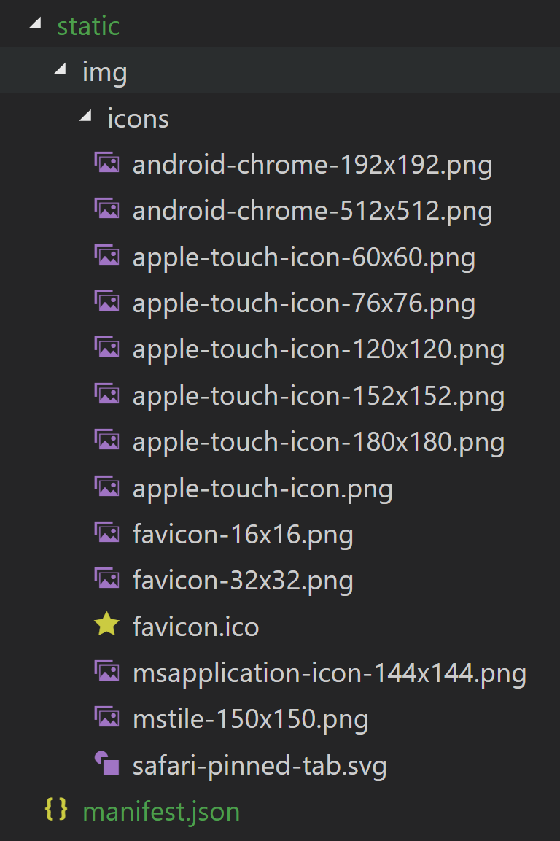
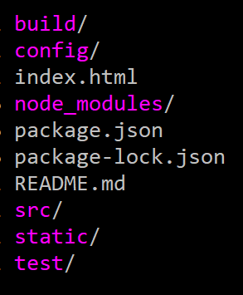

Slide 43
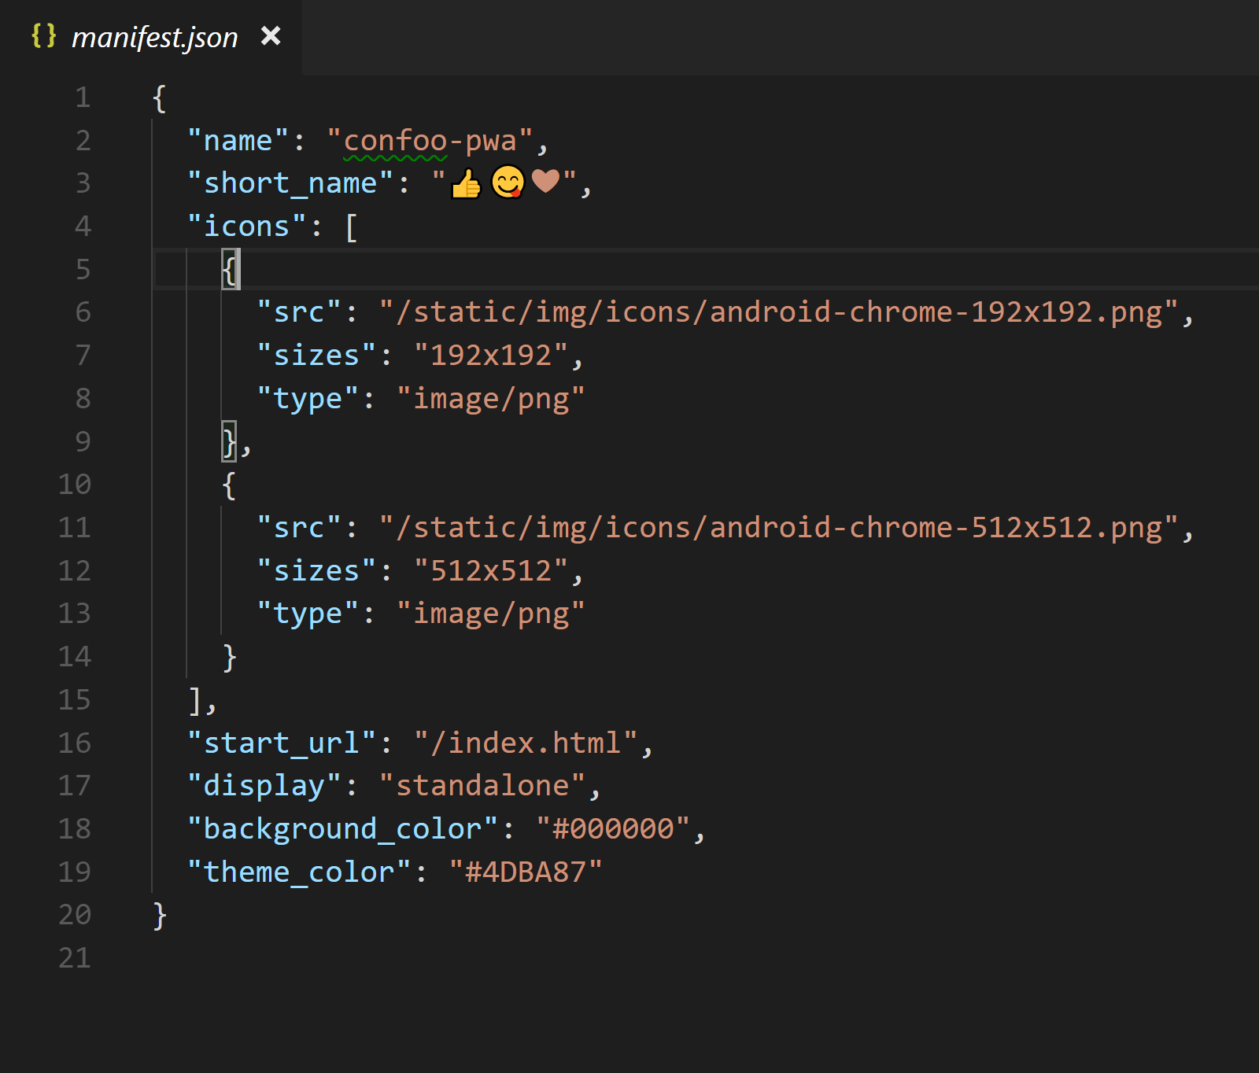

Slide 44
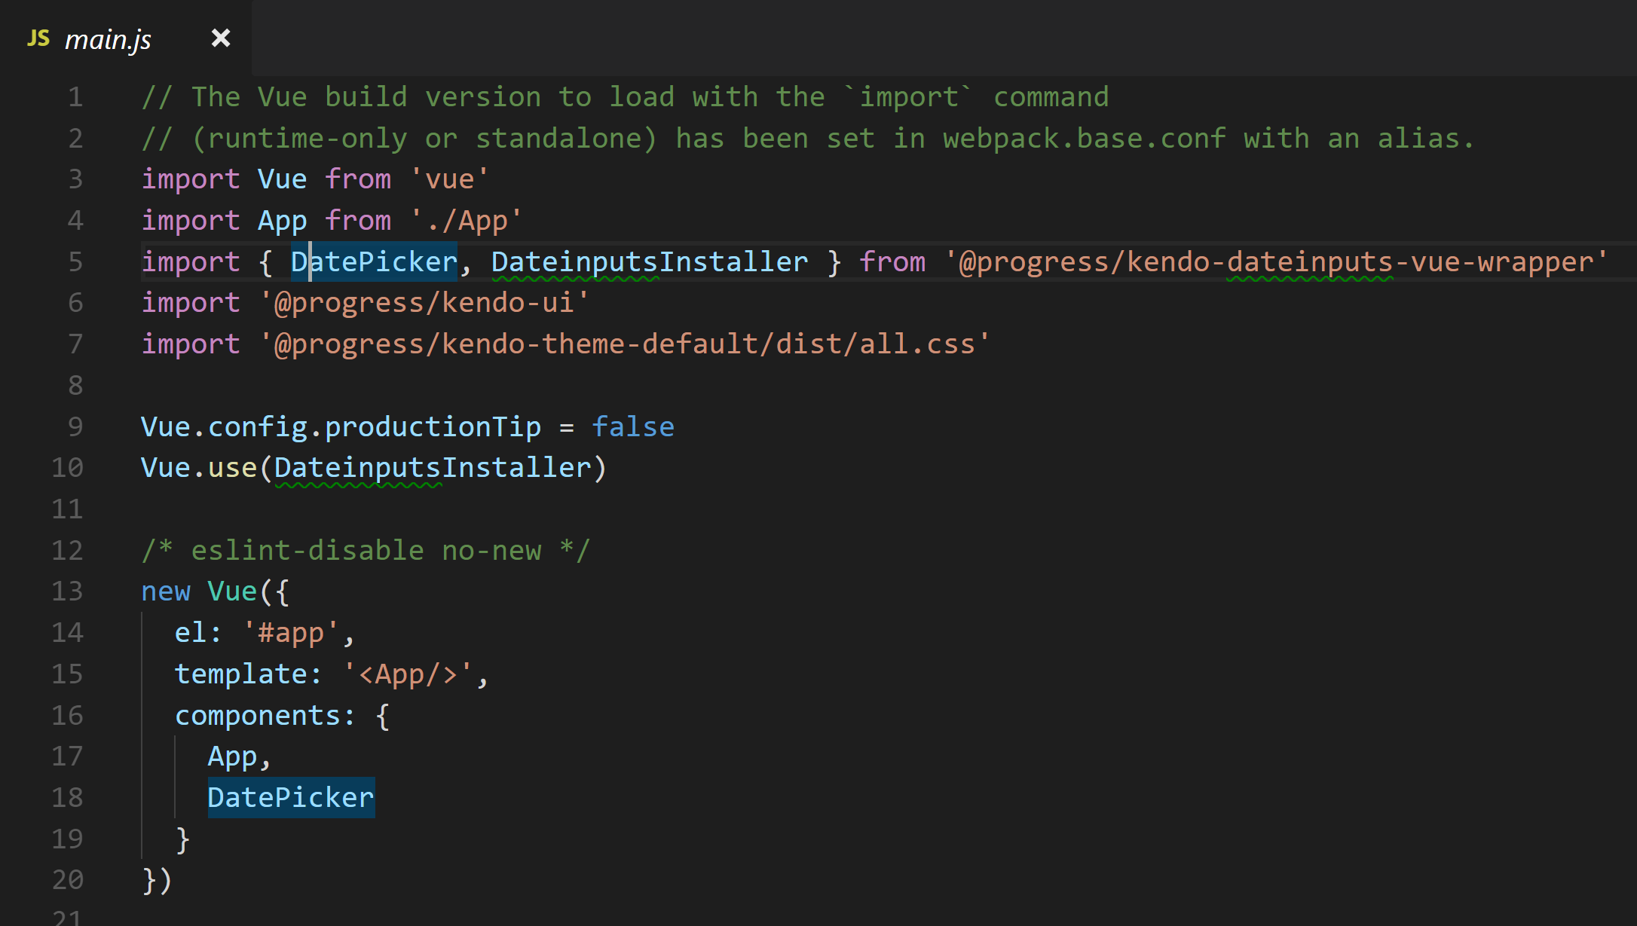

Slide 45
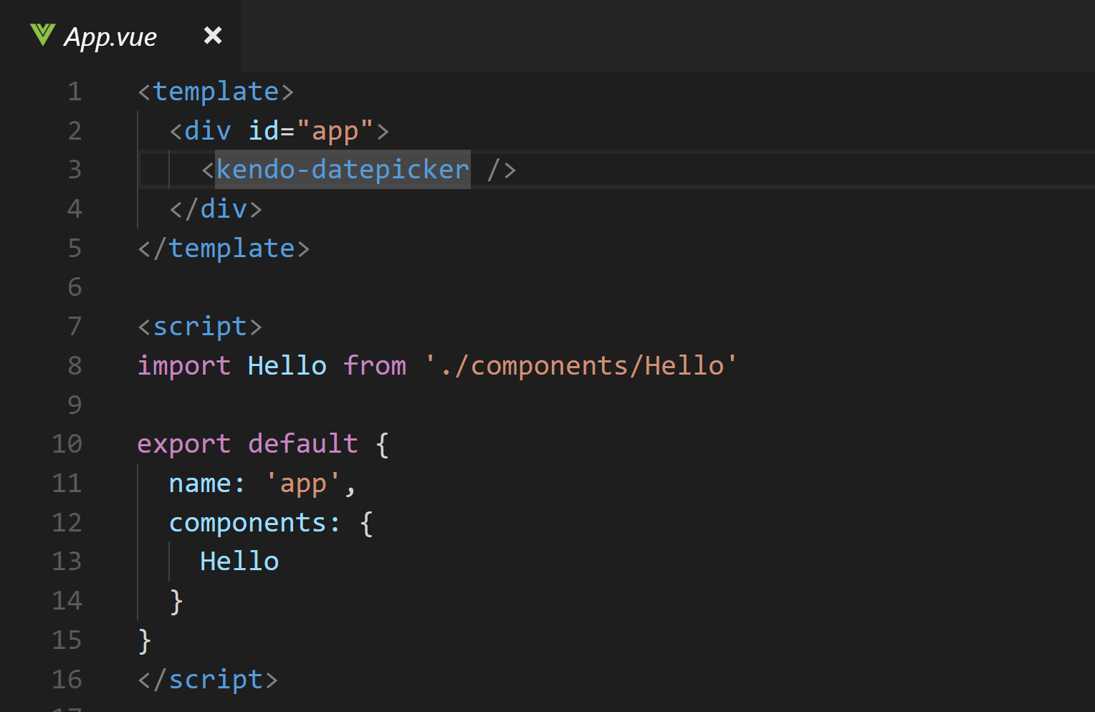

Slide 46
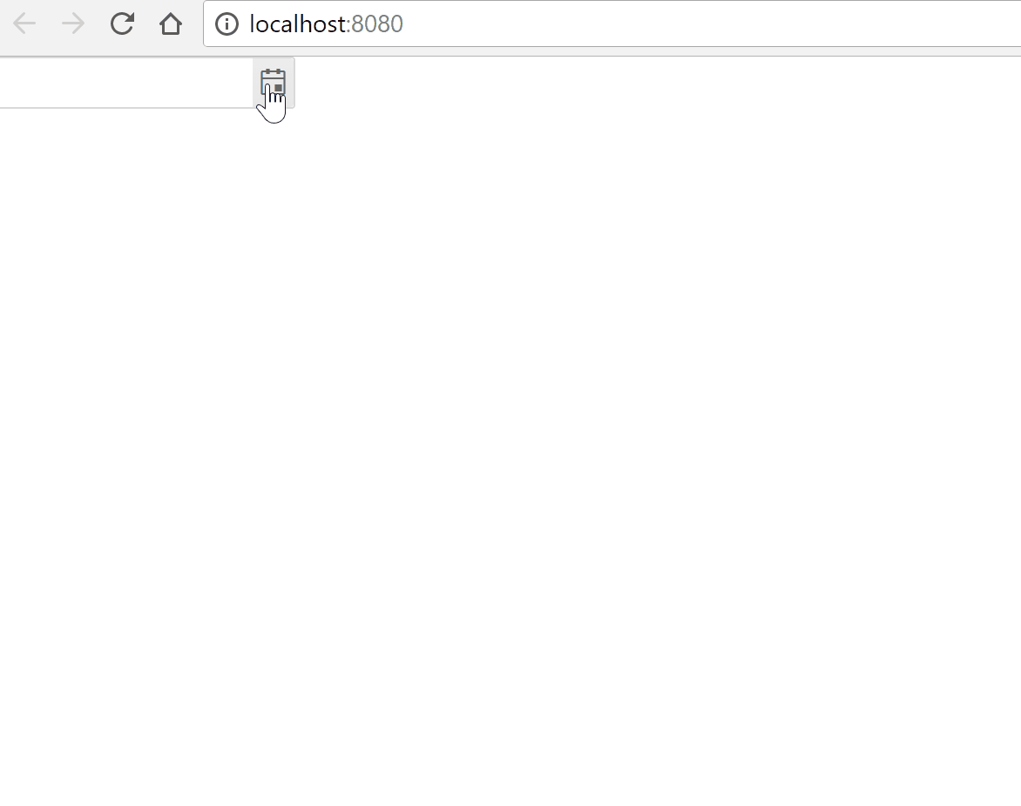

Slide 47
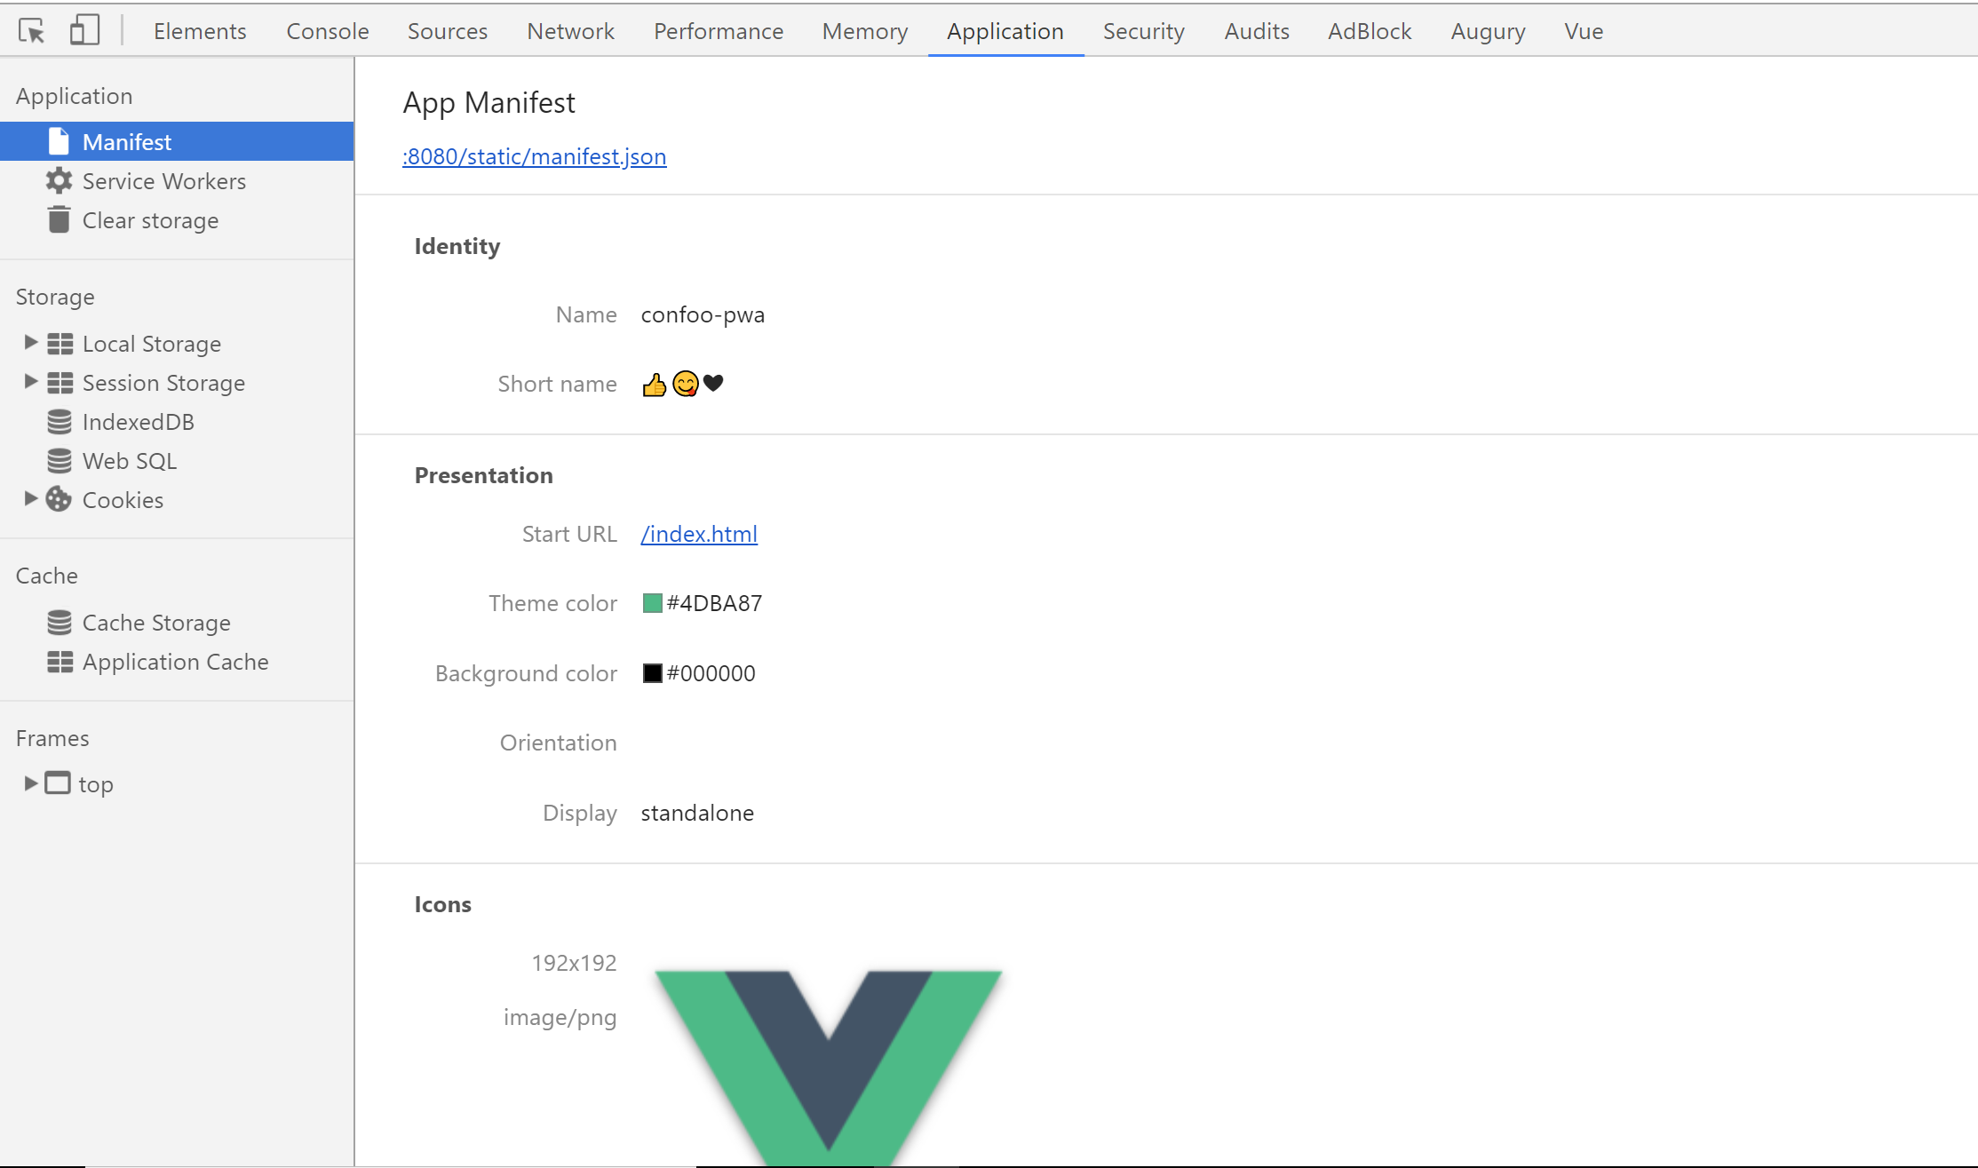

Slide 48
</live-code-screenshots>

Slide 49
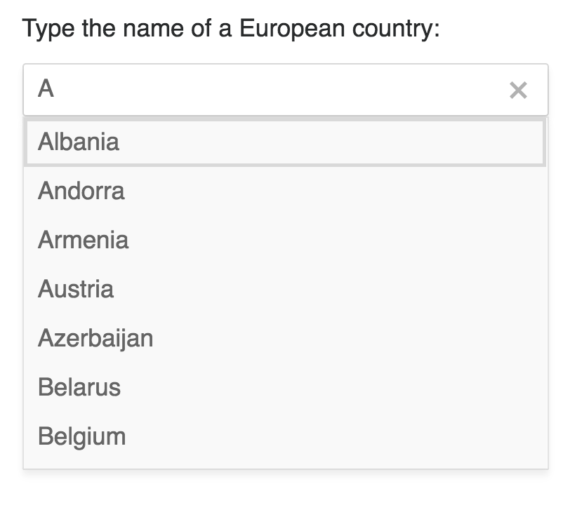
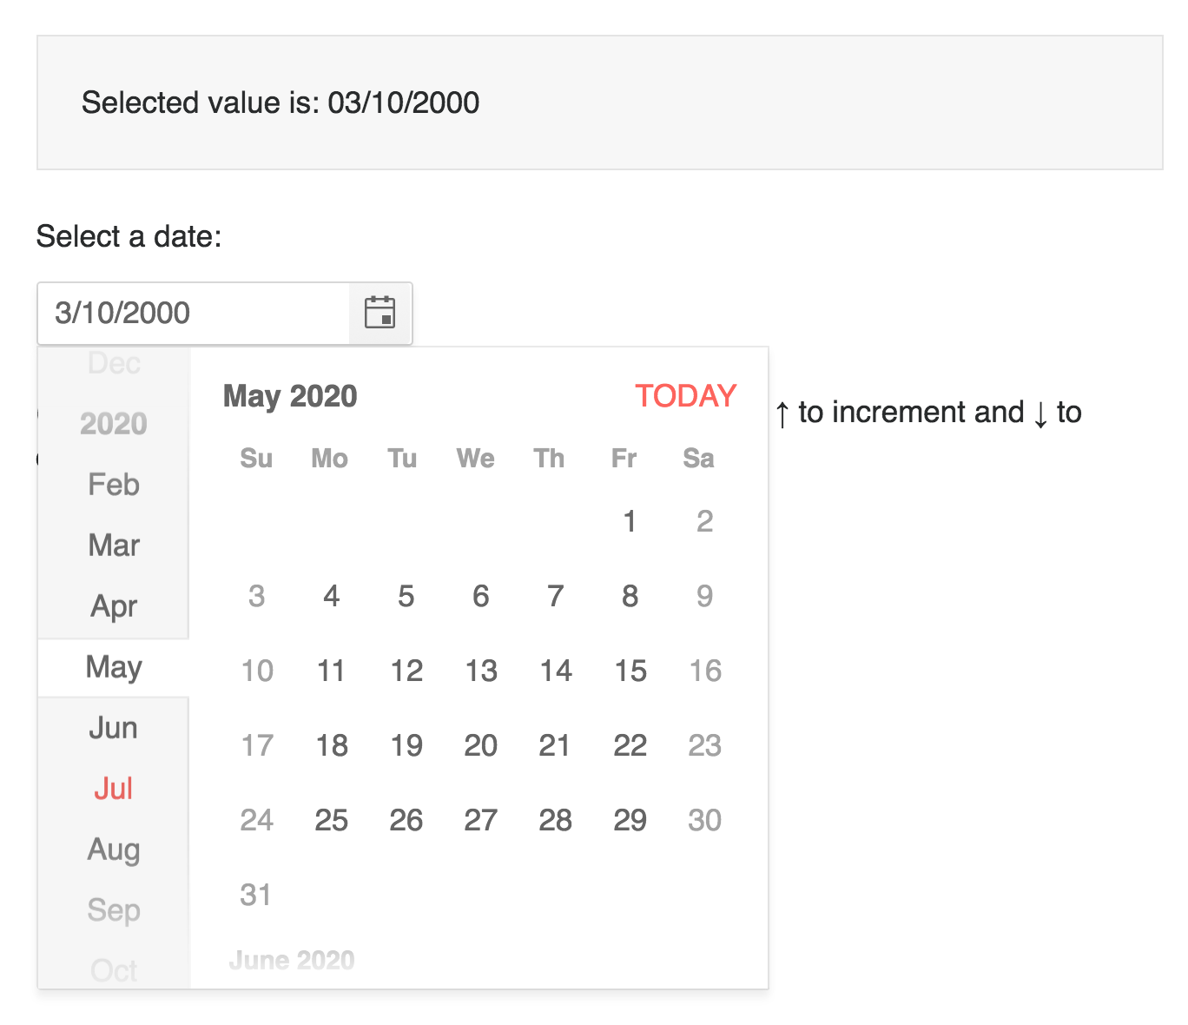
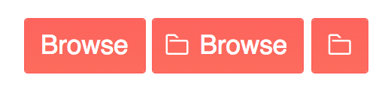
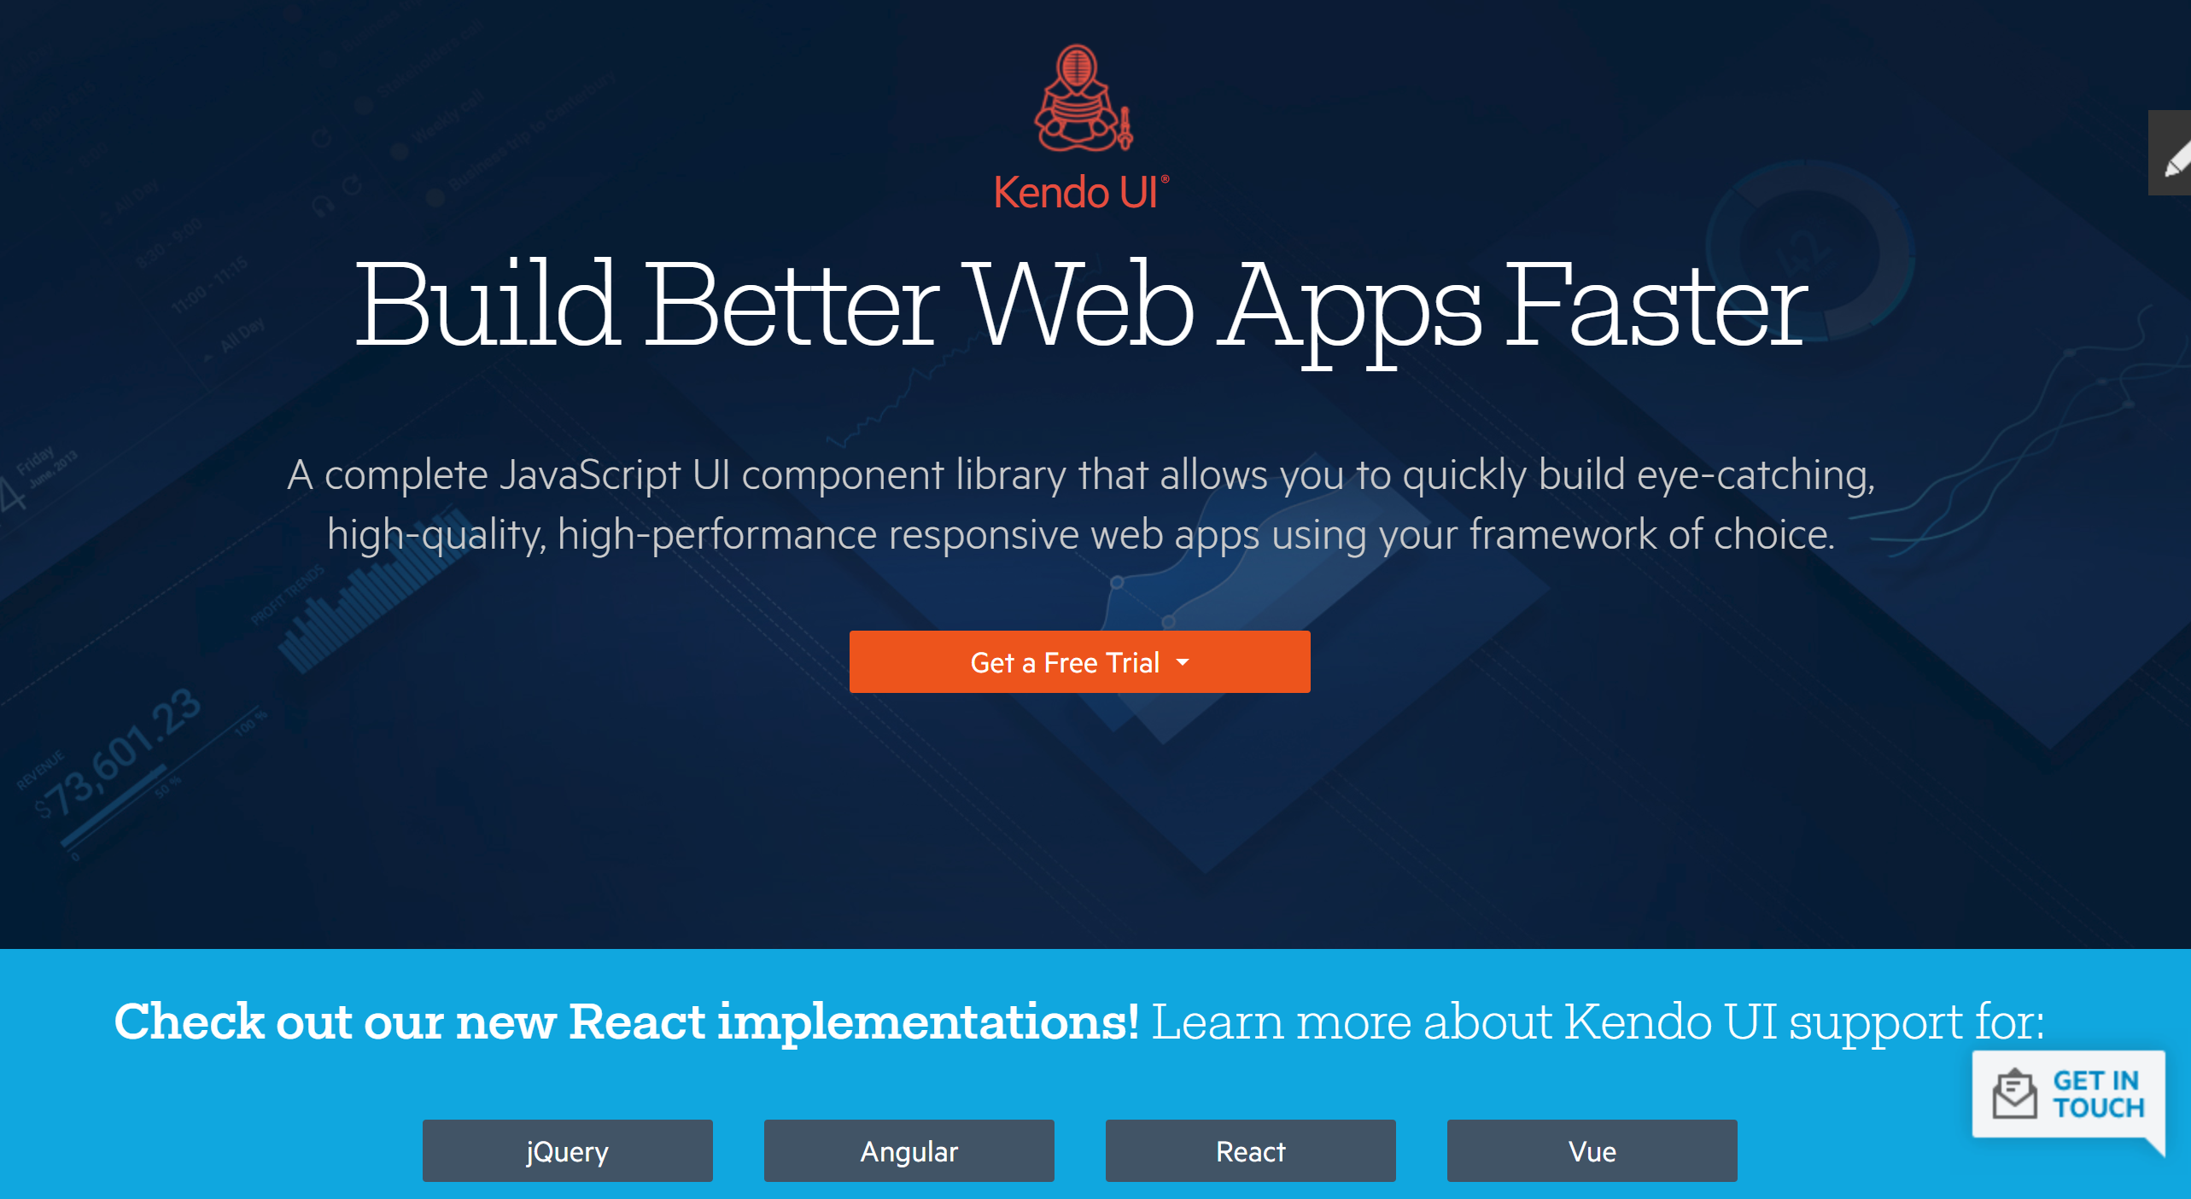

Kendoui.com
@TZMANICS
Notes:
43:00
Section 508 compliance
W3C Web Content Accessibility Guidelines (WCAG) 2.0
WAI-ARIA
Keyboard navigation requirements

Slide 50
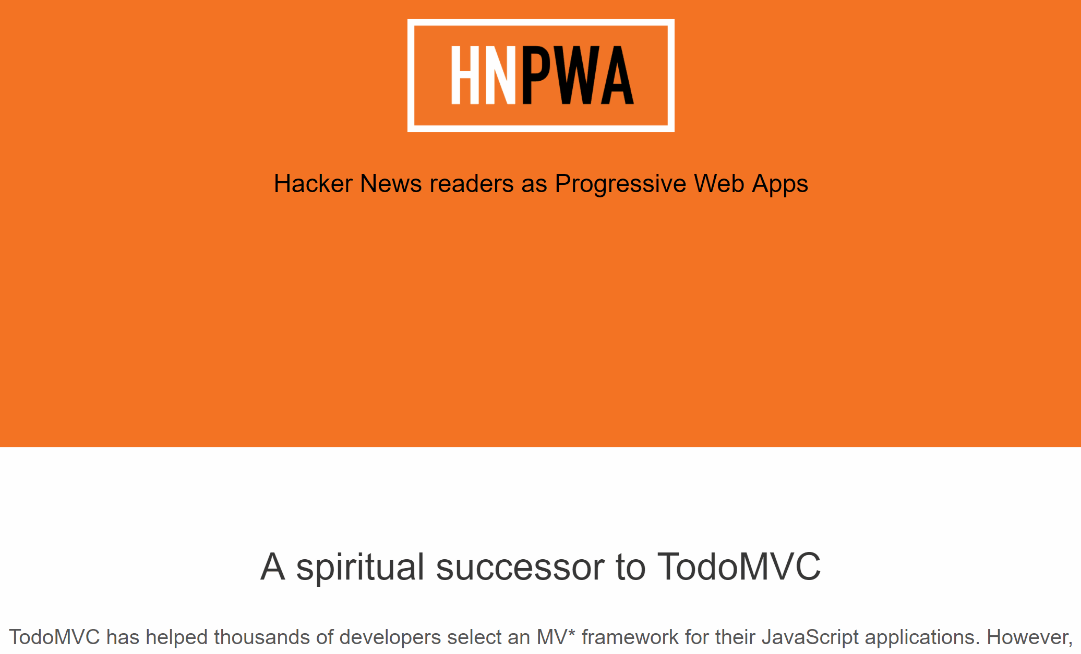

Slide 51
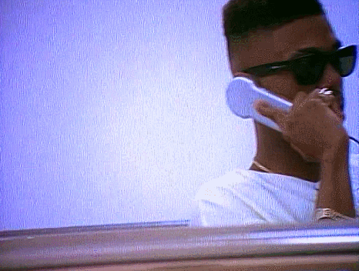
COME & TALK TO ME
i really wanna know you

Slide 52

THANKS FLUENT ❤
SLIDES & CODE WILL BE TWEETED FROM
@tzmanics

